Slide 1

A.I.A. Leadership Training
Informed and Effective Leadership

Slide 2

Let’s go to 7-Eleven

Slide 3

Leadership quotes
A leader is best when people barely know he exists, when his work is done, his aim fulfilled, they will say: we did it ourselves. —Lao Tzu
The first responsibility of a leader is to define reality. The last is to say thank you. In between, the leader is a servant. —Max DePree
Leadership is the capacity to translate vision into reality. —Warren Bennis
Lead me, follow me, or get out of my way. — General George Patton

Slide 4

Leadership quotes
Before you are a leader, success is all about growing yourself. When you become a leader, success is all about growing others. —Jack Welch
You don’t need a title to be a leader. –Multiple Attributions
A leader is one who knows the way, goes the way, and shows the way. —John Maxwell
The capacity and the will to rally men and women to a common purpose and the character which inspires confidence. —General Montgomery

Slide 5
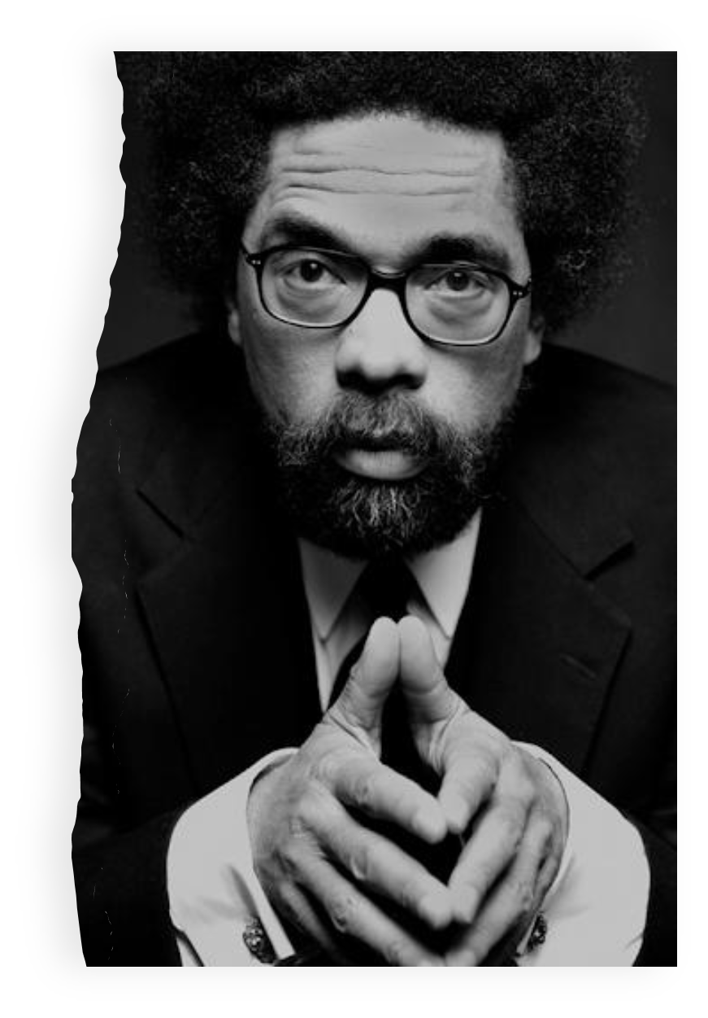
Dr. Cornell West
“You can't lead the people if you don't love the people. You can't save the people if you don't serve the people.”
“We have to recognize that there cannot be relationships unless there is commitment, unless there is loyalty, unless there is love, patience, persistence.”

Slide 6

A Biblical Perspective on Leadership
Colossians 3:15-17 “And let the peace of God rule in your hearts, to the which also ye are called in one body; and be ye thankful. 16 Let the word of Christ dwell in you richly in all wisdom; teaching and admonishing one another in psalms and hymns and spiritual songs, singing with grace in your hearts to the Lord. 17 And whatsoever ye do in word or deed, do all in the name of the Lord Jesus, giving thanks to God and the Father by him.”

Slide 7

Leadership
People often see leadership based on an “It’s all about me” approach. In all kinds of organizations and institutions, the rewards of money, recognition, and power increase as an individual moves up the hierarchy. Self-promotion (pride) and self-protection (fear) dominate today’s leadership style. Many leaders act as if the sheep are there only for the benefit of the shepherd. In personal relationships, leadership based on mutual respect, loving care, self-sacrifice, and openness is often undermined when pride, fear, and indifference replace intimacy with isolation. That’s the bad news.”

Slide 8

Biblical Leadership is not like the World
In Matthew 20, we read of James and John asking to sit at Jesus’ right and left hand. What they were really doing was asking for positions of power and status, being second only to Jesus and over the other disciples. The rest of the disciples were really upset about what James and John had done. Jesus said to them all, “You know that the rulers of the Gentiles lord it over them, and their great ones exercise authority over them. It shall not be so among you…”
“It shall not be so among you.” Jesus’ instruction to the disciples then, and therefore to Christian leaders today, was that our leadership is not to be like that of the world. As leaders serving the Kingdom of God, we are to be different to leaders in the world in how we lead others.

Slide 9
Leadership
Leadership is a process by which an executive can direct, guide, and influence the behavior and work of others towards the accomplishment of specific goals in a given situation. Leadership is the ability of a manager to induce the subordinates to work with confidence and zeal.
Leadership is the potential to influence the behavior of others. It is also defined as the capacity to influence a group towards the realization of a goal. Leaders are required to develop future visions and to motivate the organizational members to want to achieve the visions.

Slide 10
7 Biblical Models of Leadership
Paul: "Believe in something bigger than yourself."
"I have appointed you as a light for the Gentiles, to bring salvation to the ends of the earth" (Acts 13:47). Paul thought of himself as nothing in the total scheme of things. He was thoroughly subservient to the will of God, and he was committed to a specific, meaningful mission. Paul had courage in the face of opposition because he had limitless horizons in his mission. He believed in himself, but he believed in something bigger than himself, namely, "Jesus Christ and Him crucified," (1 Cor. 2:2).

Slide 11

7 Biblical Models of Leadership
Nehemiah: "Build on what God has given you."
His leadership was built not so much on ancestry from the Jewish lineage as by faithfulness. He would build the walls on faith. He was obscure in comparison to other great Old Testament heroes, but faithfulness separated him from mediocrity. God has given each leader specific gifts. Some are not as visible; all are useful.

Slide 12
7 Biblical Models of Leadership
Joshua: "Bring the best people to the table."
Joshua had been in the presence of God. A theophany had taken place in Joshua 5:15: "The commander of the Lord's army said to Joshua, "Remove the sandals from your feet, for the place where you are standing is holy." And Joshua did so."
Because of his special blessing, he was appointed as one with judicial powers and responsibilities in Joshua 14:6-15. He had a special place. He was courageous as indicated by the spy scenario in Numbers 13:31.
He was most likely the envy of other young leaders. But Moses brought him to the table of leadership because he was the best person for the job. My guess is that he had skills the like of which Moses himself admired, perhaps even envied.

Slide 13

7 Biblical Models of Leadership
Barnabas: "Bridge the gaps of differing opinions."
He was nicknamed "son of encouragement" (Acts 4:36). He bridged the gaps between the Greek and Jewish worlds. Born a Cypriot and reared a Levite, he linked the Hellenistic world and the Jerusalem church. Even when John Mark was being severely ostracized by Paul, Barnabas stood by John Mark.
He was generous and that in itself bridges the gaps of selfish and greedy people if God's grace is given the opportunity to be operative. He sold his land and gave it to the church treasury. He was not an "out front" kind of person, but rather stayed in the background as a fan and supporter of Paul. The most memorable aspect of effective leadership of a leader is when he or she has survived the polarities of differing opinions and modeled having each side respect the other's.

Slide 14

7 Biblical Models of Leadership
Moses: "Blind your eyes to petty criticism."
Moses was seen as the patient leader of a people with little faith (Ex. 16:8, 16-20). His church was a murmuring people. They complained and whined at every inconvenience (Ex. 15:24; 16: 2-3). He did get disgusted. Remember, he struck the rock and disobeyed God, but his patience had worn thin. He had had enough.
Petty criticism wears on the leader. The wise leader will work hard at blinding his or her eyes to the pettiness of church members' criticism. If that doesn't work, he outlasts them. Just about every pastor has "struck the rock" at one time or another; but then, like Moses, the same pastor usually has the resilience to see things through. Nobody said it would be easy.

Slide 15

7 Biblical Models of Leadership
Elijah: "Bind the ties of love and courage."
Today's nomenclature calls it tough love. Some call it a tough mind and a tender heart. Elijah had both. He loved God. He dared to speak to the evils of his day. Where is your God, he asked. "Perhaps he's sleeping and will wake up!" (1 Kings 18:27).
His sarcasm showed his disdain for those who had forsaken God. In every effective leader's life, there is a time for love, but also a time for courage. It may not come quickly. It will, however, come eventually. If the leader becomes a wimp, he will lose his leadership role. Effective leaders dare to speak even when it is unpopular to speak because they speak the truth with love.

Slide 16

7 Biblical Models of Leadership
Peter: "Bounce back after you are knocked down."
In Matthew 16, Peter was both a "rock" and a "stumbling block." He was both blessed and disgraced almost in the same breath. It is enough to discourage any leader. You are the foundation. You are the devil's advocate. Discouraged by the disapproval of Jesus, yet blessed by the warmth and affection of Jesus. Resilience may be the cornerstone of effective leadership. One church member compliments you on Sunday morning, the next complains about your leadership before you leave the service.

Slide 17
John 15:5
“I am the vine, you are the branches. If a man remains in me and I in him, he will bear much fruit; apart from me you can do nothing.”

Slide 18
Biblical Leadership
When leading others, following Biblical principles is perhaps the most important thing a leader should aspire to. Although it doesn’t always appear to make sense to us, if we follow God’s ways instead of our ways, we will have a more effective ministry. As Jesus’ words above teach us, “apart from God we can do nothing.” When we rely on our own intuition, talent, or experience, we often end up in places that not only cause us problems or harm, but likely dishonor God as well. We may possess tremendous leadership ability, but if it is not based on the Word of God, then we will likely lead our followers in the wrong direction.

Slide 19
Biblical Leadership
A Christian leader, therefore, is someone who stays connected to God by reading and applying His Word, who relies on the Holy Spirit working in and through them and leads others into a deeper walk with Jesus. The Bible provides us with many examples of leaders who demonstrated effective leadership skills. A review of Scripture reveals that there are 10 attributes that an effective leader exhibits:

Slide 20

Biblical Leadership
A Christian leader, therefore, is someone who stays connected to God by reading and applying His Word, who relies on the Holy Spirit working in and through them and leads others into a deeper walk with Jesus. The Bible provides us with many examples of leaders who demonstrated effective leadership skills. A review of Scripture reveals that there are 10 attributes that an effective leader exhibits:

Slide 21

11 Attributes of a Biblical Leader
(1) An effective leader must be a Visionary. The Bible says in Proverbs 29:18, “Where there is no vision, the people perish.” A leader must look to God for the vision or goal He wants them to achieve. Without a vision or a goal to works towards, the leader is not likely to achieve anything significant for the Kingdom. A leader must be able to communicate and articulate that vision in a way that inspires and encourages others to come along with them.

Slide 22
11 Attributes of a Biblical Leader
(2) An effective leader must be Mission Minded. An effective leader must remain concerned with reaching non-believers. No matter what ministry one is leading, it is imperative that the leader continues to reach out to those who need to know Jesus and receive His free gift of grace. (Matthew 28:19)

Slide 23

11 Attributes of a Biblical Leader
(3) An effective leader must be Passionate. As a leader you must care deeply about your ministry and be committed to it. Your passion for the ministry will encourage others and enable you to succeed when obstacles arise. And when these times occur, the only thing that will get you through them, besides the Lord, is your passion. (Proverbs 16:3)

Slide 24
11 Attributes of a Biblical Leader
(4) An effective leader must be Spirit-led. The effective leader knows that ministry is a partnership between the leader and God. God gives us our part to do and then He does His part. But we can never work alone or trust in our own power or abilities. An effective leader also knows that they must seek God first in all they do to make sure they are in the center of His will and purpose for their ministry. (John 15:5)

Slide 25

11 Attributes of a Biblical Leader
(5) An effective leader must be a Servant. As our Lord and Savior “did not come to be served, but to serve” (Matthew 20:28), we too must serve and not be served. This runs contrary to what the world teaches leaders to be. So, a leader is called to serve his followers and not be served by them. Consequently, a servant leader helps his followers grow & succeed.

Slide 26

11 Attributes of a Biblical Leader
(6) An effective leader must be Focused. A leader often has many responsibilities and duties to carry out in their position. It is critical for a leader to avoid being distracted by issues unrelated to their vision and mission. When your vision and mission are clear it is easier to stay focused on the goals God wants you to accomplish for the Kingdom. ( 3:13-14)

Slide 27
11 Attributes of a Biblical Leader
(7) An effective leader must be Courageous. Courage is the ability to stick to one’s beliefs when they are under attack, and to lead with conviction. The world is full of leaders who pander to the wishes of their followers, which is not really true leadership at all. A leader with courage demonstrates that they are willing to step out in faith, and to rely on God to equip them and give them the strength they need to do what God has called them to do. (1 Cor. 13:16)

Slide 28
11 Attributes of a Biblical Leader
(8) An effective leader must be Trusting. A leader trusts in God, who alone is faithful and true. It can be said that faith is a measure of how much you trust God. So an effective leader puts his trust in God and God alone, and relies on Him to do what His Word has promised. “Trust in the Lord with all your heart and lean not on your own understanding.” Proverbs 3:5

Slide 29
11 Attributes of a Biblical Leader
(9) An effective leader must be Prepared. A leader must expect the unexpected and be prepared to lead, manage or minister as needed in any given situation. Preparation takes sacrifice and planning ahead. Virtually all successful leaders have had a major crisis that required their leadership, and being prepared for that situation is what allowed them to be successful. (2 Timothy 4:2)

Slide 30
11 Attributes of a Biblical Leader
(10) An effective leader must be Opportunistic. Successful leaders are those leaders who are able to navigate through difficult times as well as take advantage of new opportunities. Leaders should take advantage of the opportunities God gives them today and not just plan for the future or stay stuck in the past. In order to do that a leader must be prepared and alert for those opportunities. Success happens where opportunity meets preparation. (1 Peter 3:15)

Slide 31
11 Attributes of a Biblical Leader
(11) An effective leader must be Respectful and Respected. An effective leader must be respectful to those that he or she leads and respected by them. 1 Thessalonians 5:12-13 “We ask you, brothers, to respect those who labor among you and are over you in the Lord and admonish you, and to esteem them very highly in love because of their work. Be at peace among yourselves.”

